Slide 1
The impact of COVID-19 on gay and bisexual men’s HIV-related behaviour: results from the Perth Gay Community Periodic Survey
Martin Holt & Curtis Chan
m.holt@unsw.edu.au
@martinxholt

Slide 2
Repeated, cross-sectional, community-based survey on HIV and sexual health for gay and bisexual men
Conducted every ~2 years since 1998
Recruitment at gay venues and events conducted by WAAC during Perth Pride; online recruitment added in 2016
In 2021, WAAC also ran online advertising
Partnership between CSRH, the Kirby Institute, WAAC, Curtin University and WA Health
Reports available from CSRH website

Slide 3
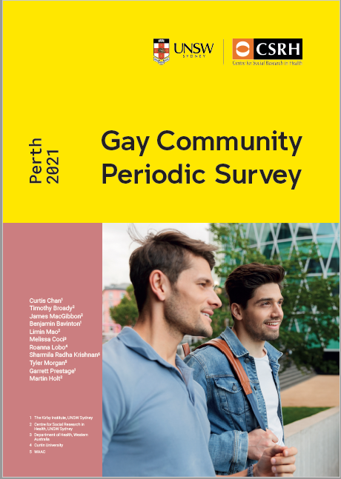
The 2021 round
First round conducted after COVID-19 emerged
1,013 participants
47% from venues/events, 53% online
81% gay, 16% bisexual
67% Australian born
89% from greater Perth area
50% university degree
66% full-time employed
4% Aboriginal or Torres Strait Islander

Slide 4
COVID-19 impacts
19% had lost income or their job
42% had been tested for COVID-19
31% had reduced their no. of sexual partners
88% had two or more COVID-19 vaccine doses
Of former/current PrEP users:
70% had reduced use
8% had stopped due to COVID-19

Slide 5
HIV testing

Slide 6
No. of HIV tests in previous year

Slide 7
HIV status (2021)

Slide 8
HIV treatment and viral load

Slide 9
PrEP awareness and use

Slide 10
PrEP use by GBM interstate (2021)

Slide 11
Sex with casual male partners (last 6m)

Slide 12
Sex with casual male partners (last 6m)
Net prevention coverage
74.1% in 2021

Slide 13
STI testing and diagnoses

Slide 14
Summary
COVID-19 caused disruptions to gay/bi men’s employment and sexual behaviour
Vaccination uptake was high
HIV/STI testing frequency declined from 2019 to 2021, but STI diagnoses remained stable
HIV treatment remained consistently high
PrEP use continued to increase, with event-driven dosing playing a greater role
‘Net prevention coverage’ increased but 1 in 4 GBM reported some risk of HIV with casual partners

Slide 15
Acknowledgments
WAAC: Michael Atkinson, Tyler Morgan, Josephine Rayson, Sharmila Radha Krishnan, and the peer recruiters
Department of Health, Western Australia: Lisa Bastian, Melissa Coci
SiREN, Curtin University: Roanna Lobo
Centre for Social Research in Health: Timothy Broady, James MacGibbon, Limin Mao
Kirby Institute: Ben Bavinton, Garrett Prestage

